Slide 1
Convolutional Neural Networks I

Slide 2

A Convolutional Network
+ ReLU
+ ReLU

Slide 3
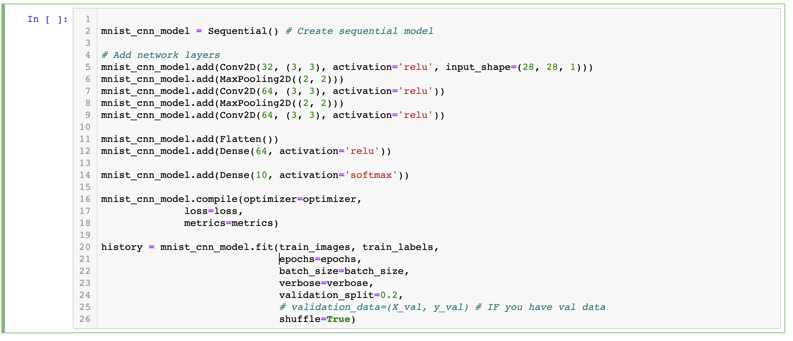
The code

Slide 4
DONE

Slide 5
A Convolutional Network
+ ReLU
+ ReLU
What is this square?

Slide 6
A Convolutional Network
+ ReLU
+ ReLU
What is this square?
What are feature maps and why multiple feature maps?

Slide 7
A Convolutional Network
+ ReLU
+ ReLU
What is this square?
What are feature maps and why multiple feature maps?
What is Pooling?

Slide 8
A Convolutional Network
+ ReLU
Why more than one layer?
+ ReLU
What is this square?
What are feature maps and why multiple feature maps?
What is Pooling?

Slide 9
A Convolutional Network
+ ReLU
Why more than one layer?
+ ReLU
What is this square?
What are feature maps and why multiple feature maps?
What is going on here?
What is Pooling?

Slide 10
Outline
Motivation
CNN basic ideas
Building a CNN

Slide 11
Outline
Motivation
CNN basic ideas
Building a CNN

Slide 12
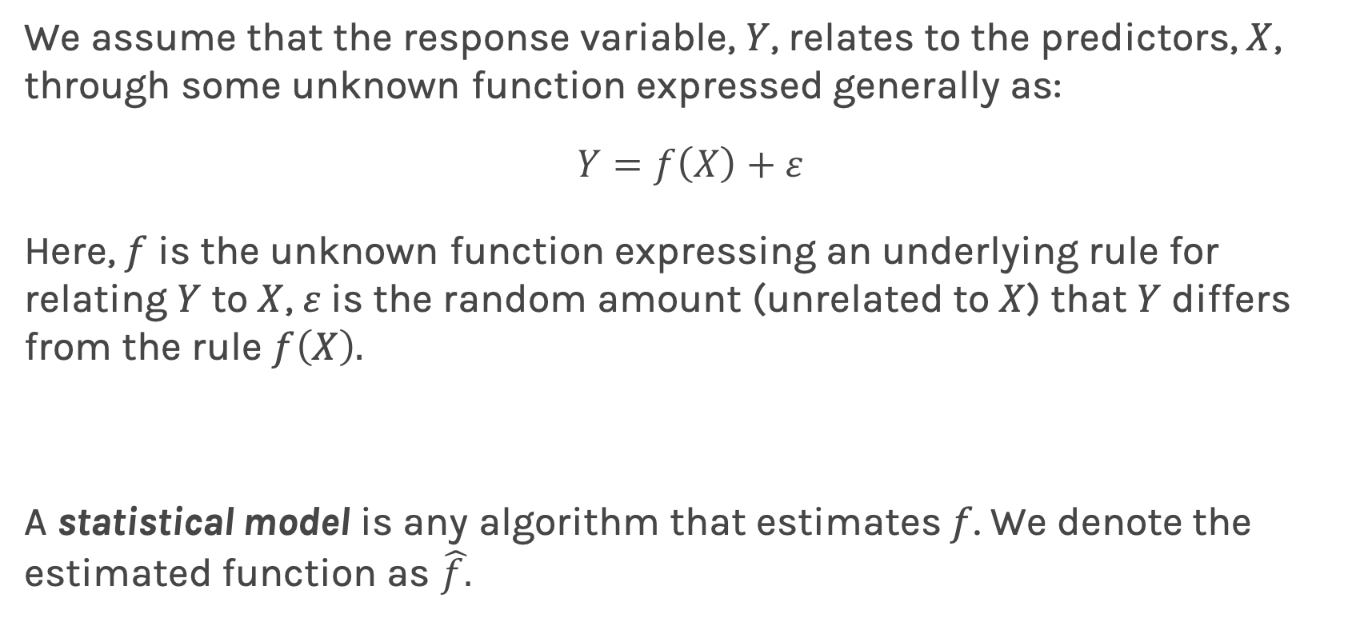
Feed forward Neural Network, Multilayer Perceptron (MLP)
We assume that the response variable, $Y$, relates to the predictors, $X$, through some unknown function expressed generally as:
$$Y=f\left(X\right)+ε$$
Here, $f$ is the unknown function expressing an underlying rule for relating $Y$ to $X$, $ε$is the random amount (unrelated to $X$) that $Y$ differs from the rule $f\left(X\right).$
A statistical model is any algorithm that estimates $f$. We denote the estimated function as $\hat{f.}$

Slide 13
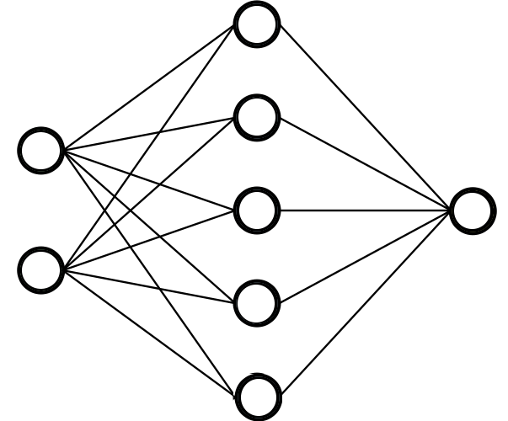
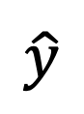

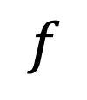
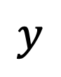
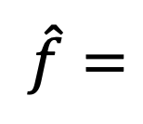
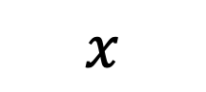
Feed forward Neural Network, Multilayer Perceptron (MLP)
A function is a relation that associates each element $x$ of a set $X$ to a single element $y$ of a set $Y$
$$x$$
$$f$$
$$y$$
Neural networks can approximate a wide variety of functions
$$x$$
$\hat{f}=$
$$\hat{y}$$

Slide 14
Quick review of MLPs
Loss function
input
output layer
hidden layer 1
hidden layer 2

Slide 15
Quick review of MLPs
I do not like calling it a layer
Loss function
input
output layer
hidden layer 1
hidden layer 2

Slide 16
Quick review of MLPs
Activation depends on task
I do not like calling it a layer
Loss function
input
output layer
hidden layer 1
hidden layer 2

Slide 17
Quick review of MLPs
Activation depends on task
I do not like calling it a layer
Loss function
input
output layer
Loss function depends on task
hidden layer 1
hidden layer 2

Slide 18
Quick review of MLPs
Activation depends on task
I do not like calling it a layer
Loss function
input
output layer
Loss function depends on task
hidden layer 1
hidden layer 2
Learn weights and biases using backprop and gradient descent

Slide 19
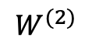
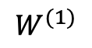
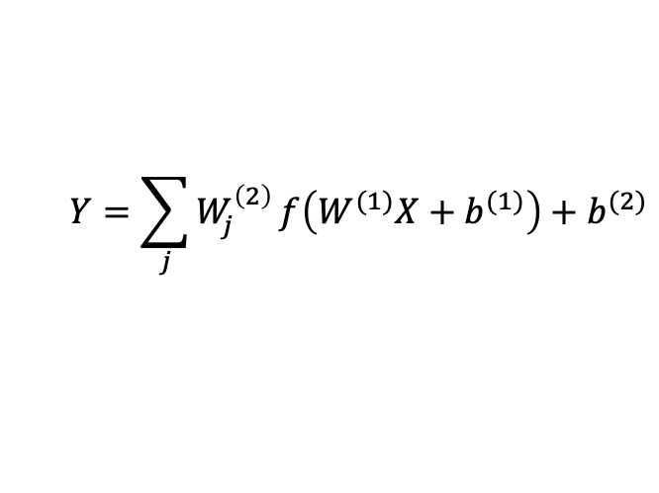
MLP as an additive model
activation
$$W^{(1)}$$
$$W^{(2)}$$
$$Y=\sum_{j}{W_{j}^{\left(2\right)}}f\left(W^{(1)}X+b^{(1)}\right)+b^{(2)}$$
X
Y
input
output layer
hidden layer 1

Slide 20
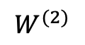
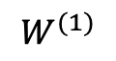
MLP as an additive model
activation
$$W^{(1)}$$
$$W^{(2)}$$
$$Y=\sum_{j}{W_{j}^{\left(2\right)}}f\left(W^{(1)}X+b^{(1)}\right)+b^{(2)}$$
X
Y
Basis functions.
input
output layer
hidden layer 1

Slide 21
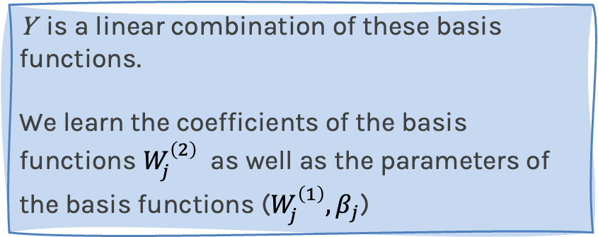
MLP as an additive model
activation
$$W^{(1)}$$
$$W^{(2)}$$
$$Y=\sum_{j}{W_{j}^{\left(2\right)}}f\left(W^{(1)}X+b^{(1)}\right)+b^{(2)}$$
X
Y
Basis functions.
input
Y is a linear combination of these basis functions.
We learn the coefficients of the basis functions $W_{j}^{\left(2\right)}$ as well as the parameters of the basis functions ($W_{j}^{\left(1\right)}, β_{j}$)
output layer
hidden layer 1

Slide 22
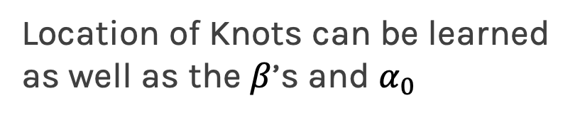
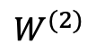
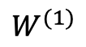
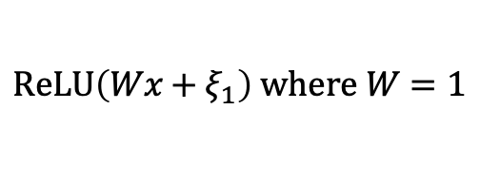
MLP as an additive model (cont)
From lecture 1:
E(Y|x)$=α_{0}+α_{1}x+β_{1}{\left(x−ξ_{1}\right)}_{+}$+$β_{2}{\left(x−ξ_{2}\right)}_{+}+…+β_{k}{\left(x−ξ_{k}\right)}_{+}$
Minor modification:
E(Y|x)$=α_{0}+β_{0}{\left(x−∞\right)}_{+}+β_{1}{\left(x−ξ_{1}\right)}_{+}$+$β_{2}{\left(x−ξ_{2}\right)}_{+}+…+β_{k}{\left(x−ξ_{k}\right)}_{+}$
$$ReLU\left(Wx+ξ_{1}\right) where W=1$$
$$W^{(1)}$$
$$W^{(2)}$$
Location of Knots can be learned as well as the $β$’s and $α_{0}$
X
Y
input layer
hidden layer 1

Slide 23
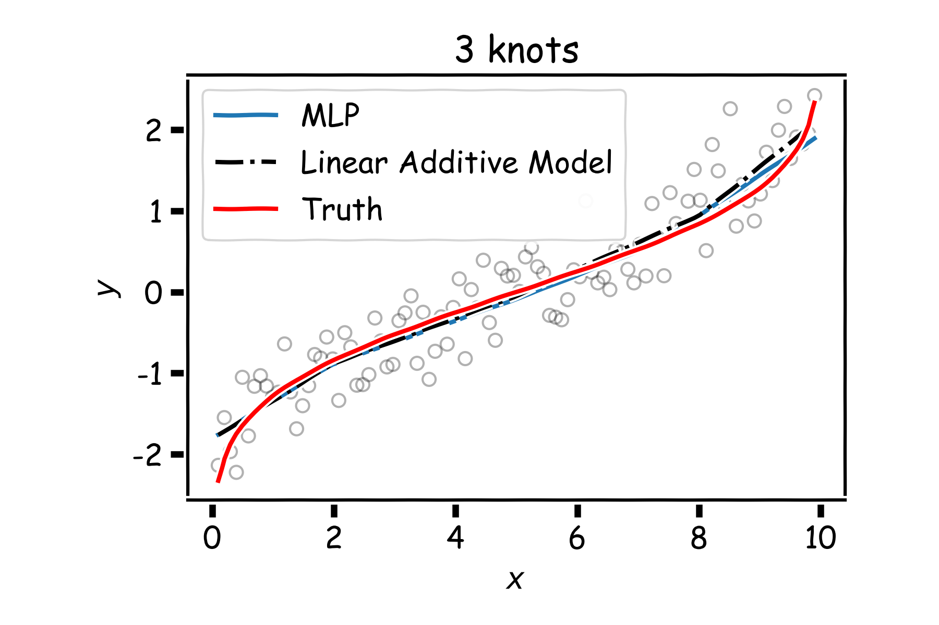
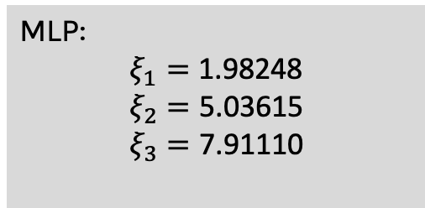
MLP as an additive model (cont)
MLP:
$$ξ_{1}=\text{1.98248}$$
$$ξ_{2}=\text{5.03615}$$
$$ξ_{3}=\text{7.91110}$$

Slide 24
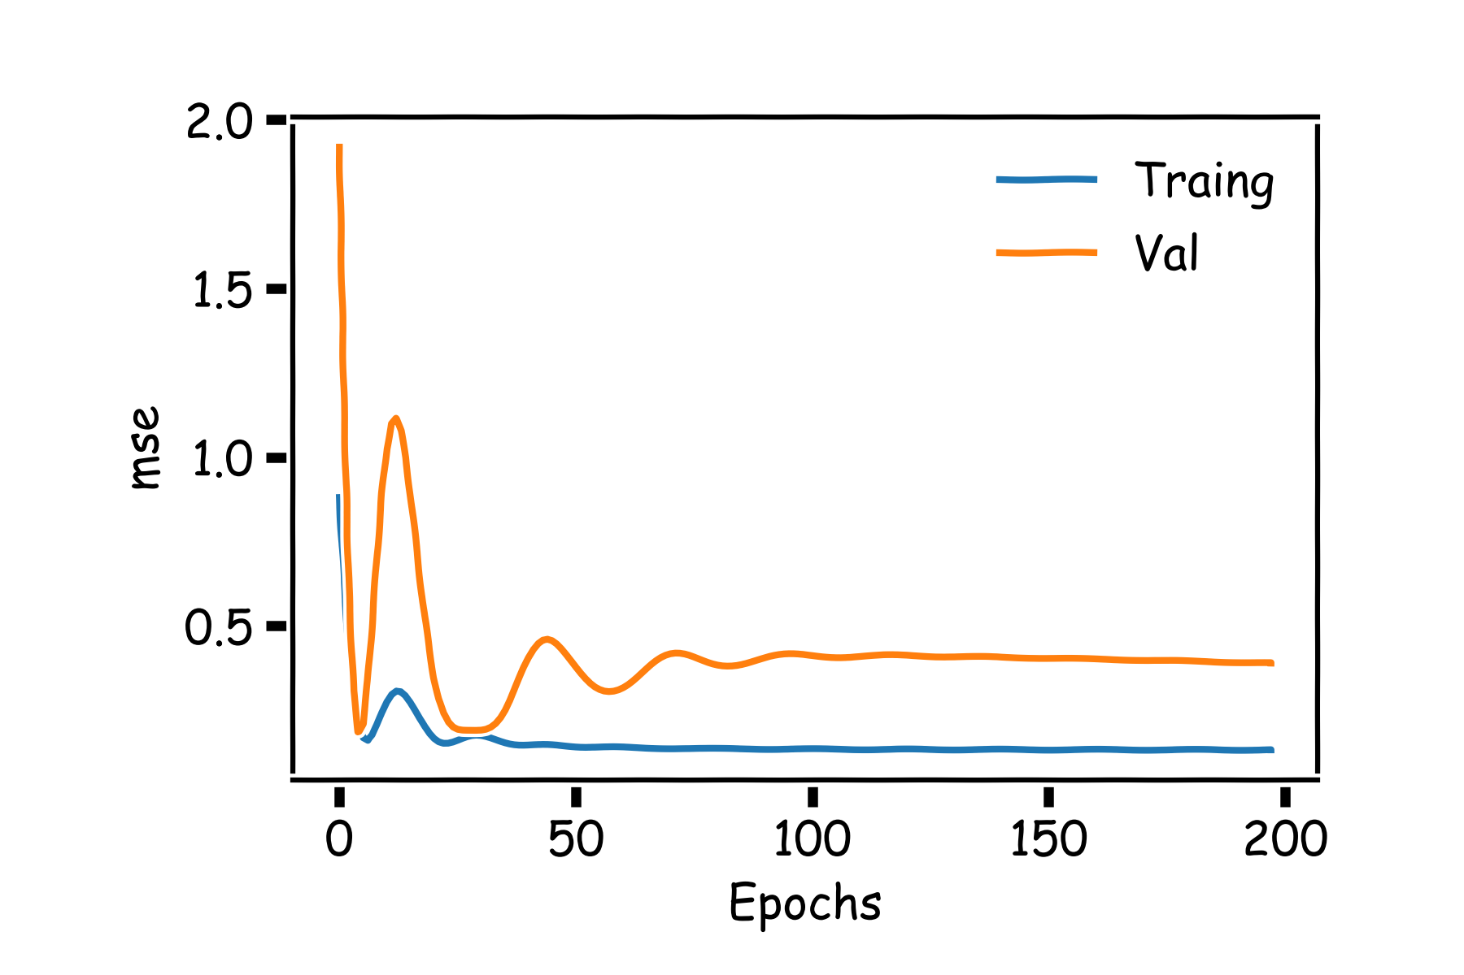
MLP as an additive model (cont)
If we add more neurons, it clearly overfits.
Regularization of NN
Norm Penalties
Early Stopping
Data Augmentation
Dropout
[batch normalization]

Slide 25
Main drawbacks of MLPs
MLPs use one node for each input (e.g. pixel in an image, or 3 pixel values in RGB case). The number of weights rapidly becomes unmanageable for large images.
Training difficulties arise, overfitting can appear.
MLPs react differently to an input (images) and its shifted version – they are not translation invariant.

Slide 26
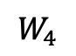
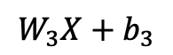
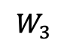
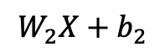
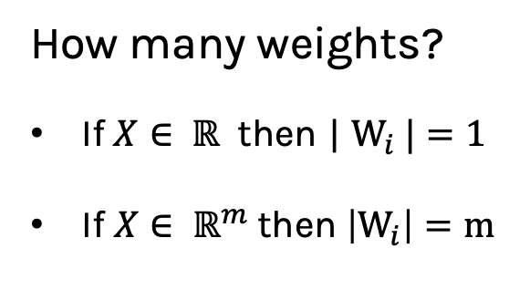
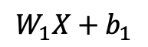
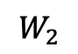
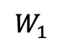
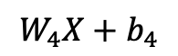
MLP: number of weights
$$W_{1}X+b_{1}$$
$$W_{1}$$
How many weights?
If $X∈ ℝ$ then | $W_{i} |=1$
If $X∈ ℝ^{m}$then $\left|W_{i}\right|=m$
$$W_{2}$$
$$W_{2}X+b_{2}$$
X
$$W_{3}$$
$$W_{4}$$
$$W_{3}X+b_{3}$$
input
$$W_{4}X+b_{4}$$
hidden layer 1

Slide 27

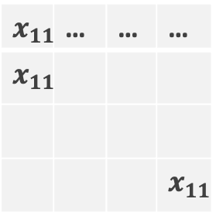
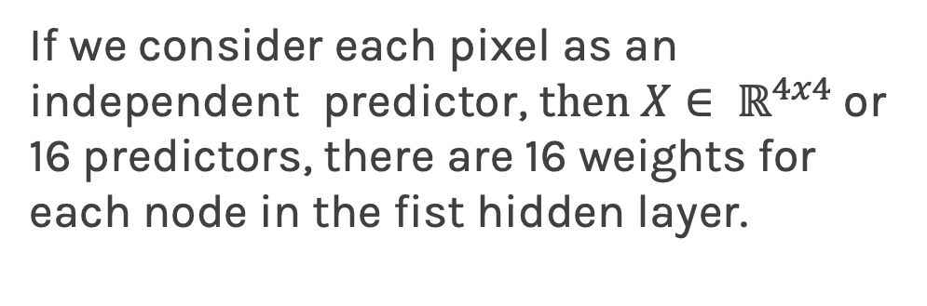
MLP: number of weights for images
If we consider each pixel as an independent predictor, t$hen X∈ ℝ^{4x4}$or 16 predictors, there are 16 weights for each node in the fist hidden layer.
$$x_{11}$$ | … | … | …
$$x_{11}$$
 |  |  | $$x_{11}$$
A strong motivation for performing model selection is to avoid overfitting, which we saw can happen when:
there are too many predictors
the feature space is high dimensional
the polynomial degree is too high
too many cross-terms are considered

Slide 28
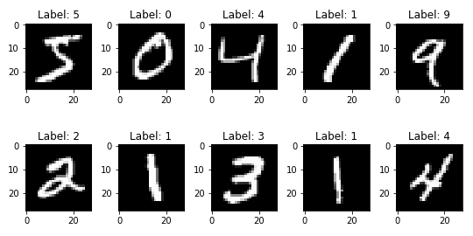
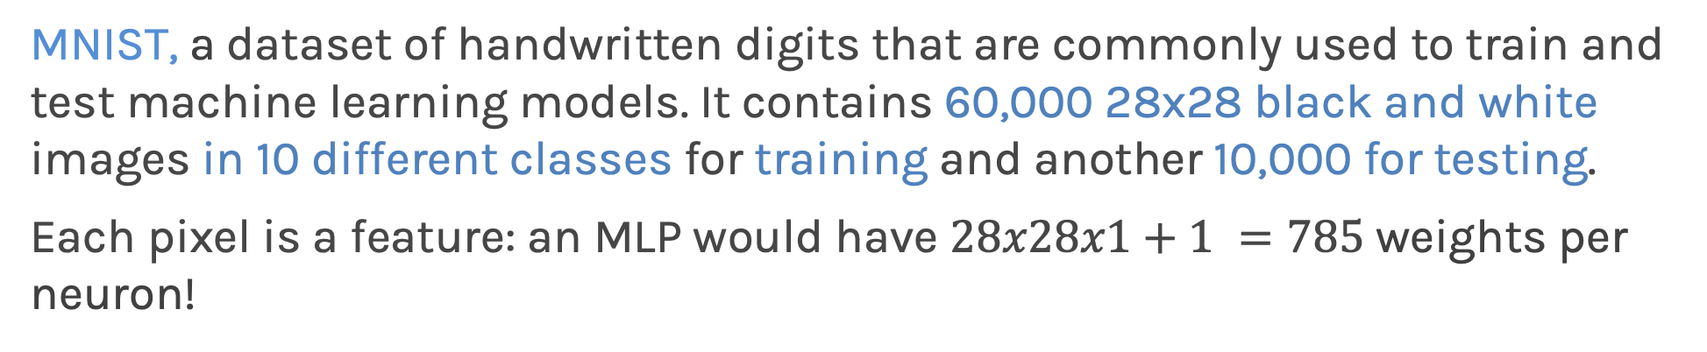
Common Dataset: MNIST
MNIST, a dataset of handwritten digits that are commonly used to train and test machine learning models. It contains 60,000 28x28 black and white images in 10 different classes for training and another 10,000 for testing.
Each pixel is a feature: an MLP would have $28x28x1+1 =785$weights per neuron!

Slide 29
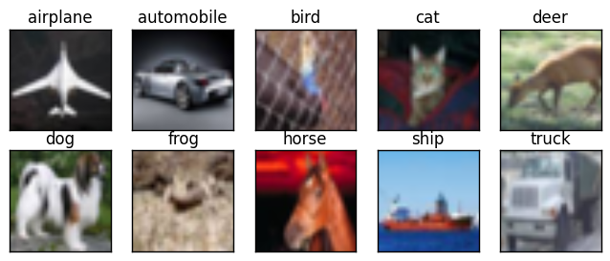
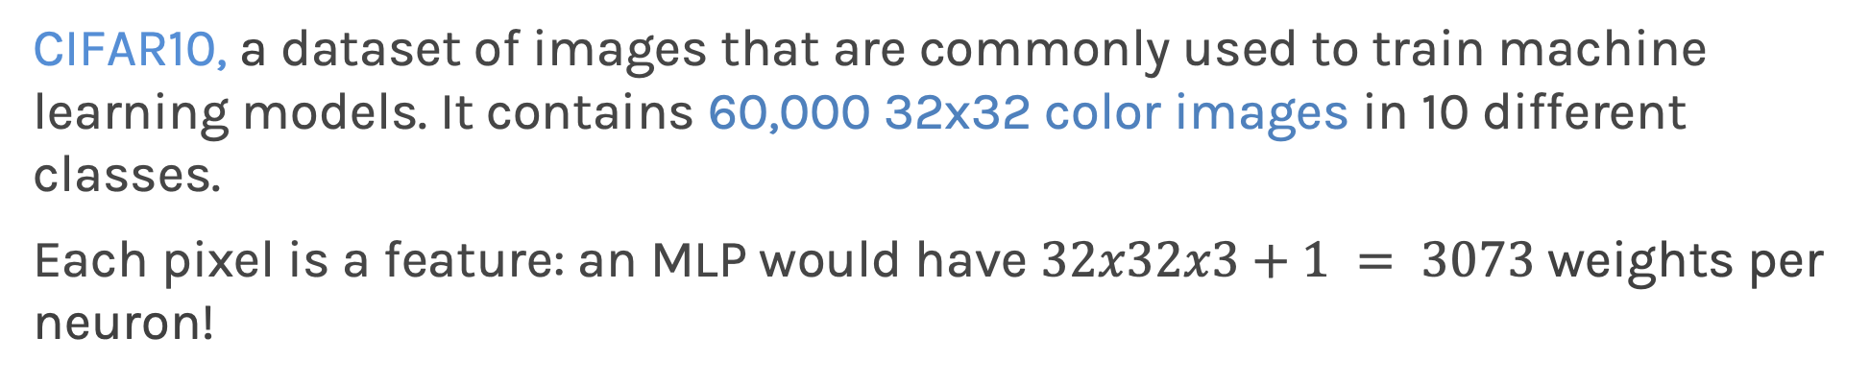
Common Dataset: CIFAR10
CIFAR10, a dataset of images that are commonly used to train machine learning models. It contains 60,000 32x32 color images in 10 different classes.
Each pixel is a feature: an MLP would have $32x32x3+1 = 3073$weights per neuron!

Slide 30
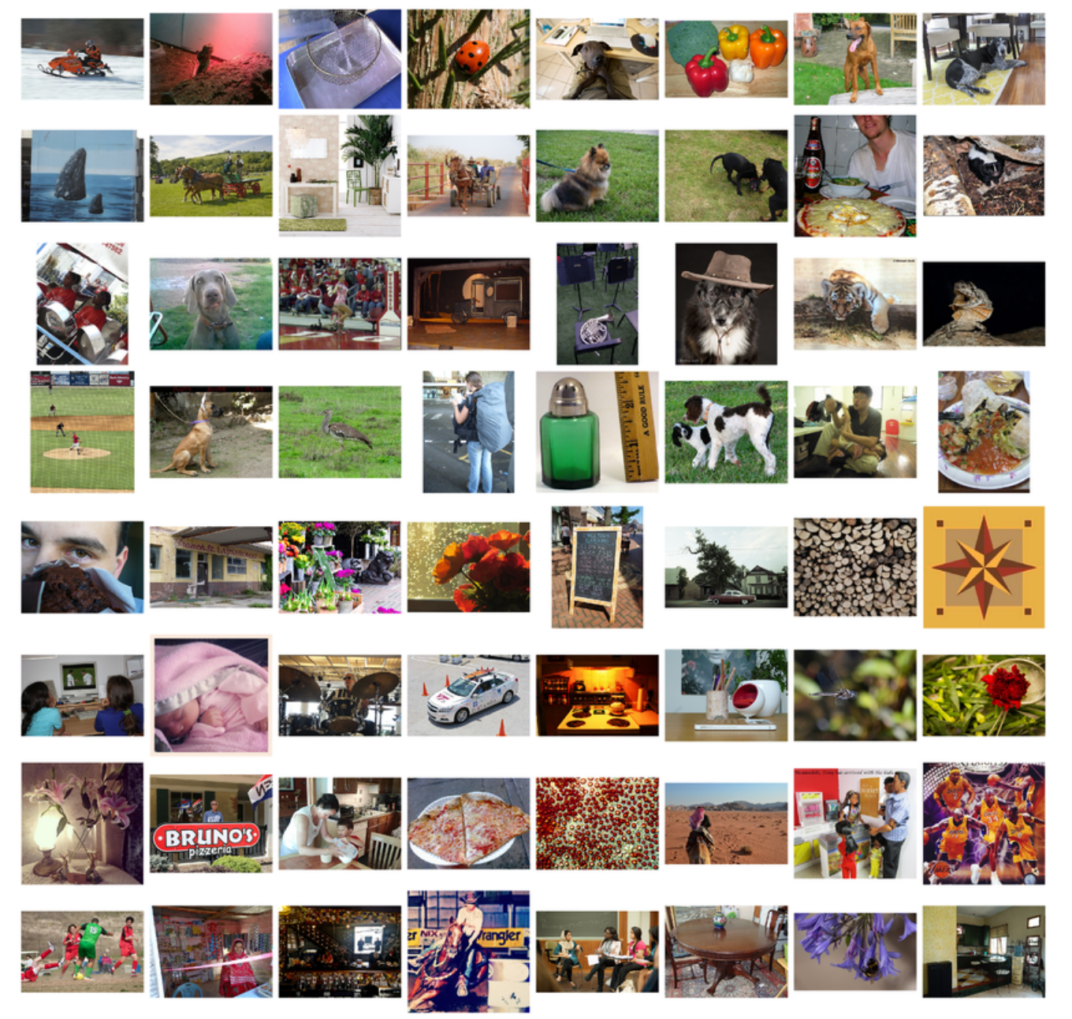
Common Dataset: ImageNet
Example: ImageNet, a large visual database designed for use in visual object recognition software research. More than 14 million images have been hand-annotated into 1000 classes by the project to indicate what objects are pictured. In at least one million of the images, bounding boxes are also provided.
Images are usually 224x224x3: an MLP would have 150129 weights per neuron. If the first layer of the MLP is around 128 nodes, which is small, this already becomes very heavy to train.

Slide 32
Model Selection and Dimensionality Reduction
Recall from “before” that to reduce the number of predictors we can:

Slide 33
Model Selection and Dimensionality Reduction
Recall from “before” that to reduce the number of predictors we can:
PCA

Slide 34
Model Selection and Dimensionality Reduction
Recall from “before” that to reduce the number of predictors we can:
PCA
Stepwise Variable Selection

Slide 35
Model Selection and Dimensionality Reduction
Recall from “before” that to reduce the number of predictors we can:
PCA
Stepwise Variable Selection
Regularization, in particular L1 will produce sparsity

Slide 36
Model Selection and Dimensionality Reduction
Recall from “before” that to reduce the number of predictors we can:
PCA
Stepwise Variable Selection
Regularization, in particular L1 will produce sparsity
Drop predictors that are highly correlated

Slide 37
Model Selection and Dimensionality Reduction
Recall from “before” that to reduce the number of predictors we can:
PCA
Stepwise Variable Selection
Regularization, in particular L1 will produce sparsity
Drop predictors that are highly correlated
Summarize input (image) with high level features => feature extraction or representation learning

Slide 38
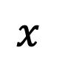
Feature extraction
Features:
Bald
Grey hair
Oval shape head
Glasses
$$x$$

Slide 39
Feature extraction
Features:
Bald
Grey hair
Oval shape head
Glasses
$$x$$
WAIT FOR IT

Slide 40
Feature extraction
Features:
Bald
Grey hair
Oval shape head
Glasses
Awesome

Slide 41
Feature extraction
Features:
Bald
Grey hair
Oval shape head
Glasses
Awesome
Features:
Bald
Grey hair
Oval shape head
No Glasses
Awesome

Slide 42

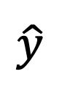
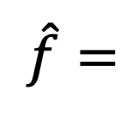
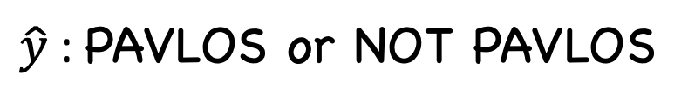
Feature extraction
Features:
Bald
Grey hair
Oval shape head
Glasses
Awesome
$\hat{y}$: PAVLOS or NOT PAVLOS
$$x$$
$$x′$$
$\hat{f}=$
$$\hat{y}$$
Features:
Bald
Grey hair
Oval shape head
No Glasses
Awesome

Slide 43
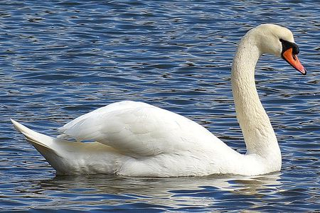
Image analysis
Imagine that we want to recognize swans in an image:
Slides from Camilo Fosco

Slide 44
Image analysis
Imagine that we want to recognize swans in an image:
Oval-shaped white blob (body)
Slides from Camilo Fosco

Slide 45
Image analysis
Imagine that we want to recognize swans in an image:
Round, elongated oval with orange protuberance
Oval-shaped white blob (body)
Slides from Camilo Fosco

Slide 46
Image analysis
Imagine that we want to recognize swans in an image:
Round, elongated oval with orange protuberance
Oval-shaped white blob (body)
Long white rectangular shape (neck)
Slides from Camilo Fosco

Slide 47
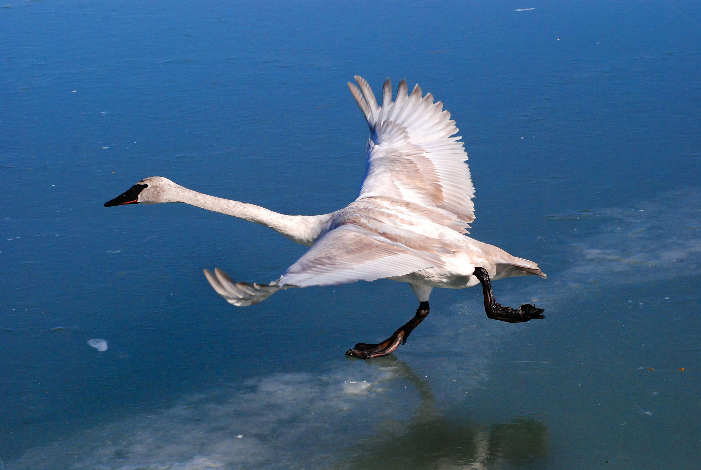
Cases can be a bit more complex…

Slide 48
Cases can be a bit more complex…
Round, elongated head with orange or black beak

Slide 49
Cases can be a bit more complex…
Round, elongated head with orange or black beak
Long white neck, square shape

Slide 50
Cases can be a bit more complex…
Round, elongated head with orange or black beak
Oval-shaped white body with or without large white symmetric blobs (wings)
Long white neck, square shape

Slide 51
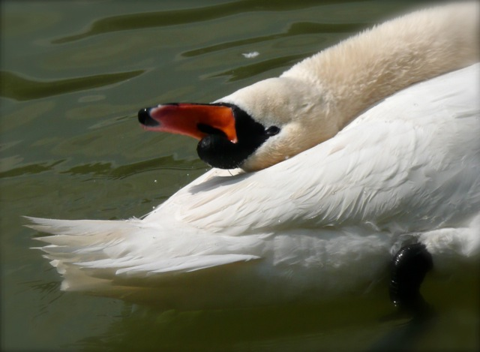
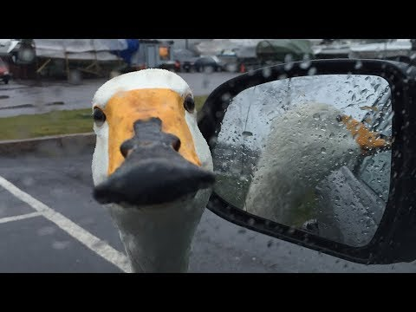
Now what?
Round, elongated head with orange or black beak, can be turned backwards
Long white neck, can bend around, not necessarily straight
White tail, generally far from the head, looks feathery
Black feet, under body, can have different shapes
White, oval shaped body, with or without wings visible

Slide 52
Now what?
Round, elongated head with orange or black beak, can be turned backwards
Small black circles, can be facing the camera, sometimes can see both
Long white neck, can bend around, not necessarily straight
Black triangular shaped form, on the head, can have different sizes
White tail, generally far from the head, looks feathery
White elongated piece, can be squared or more triangular, can be obstructed sometimes
Luckily, the color is consistent…
Black feet, under body, can have different shapes
White, oval shaped body, with or without wings visible

Slide 53
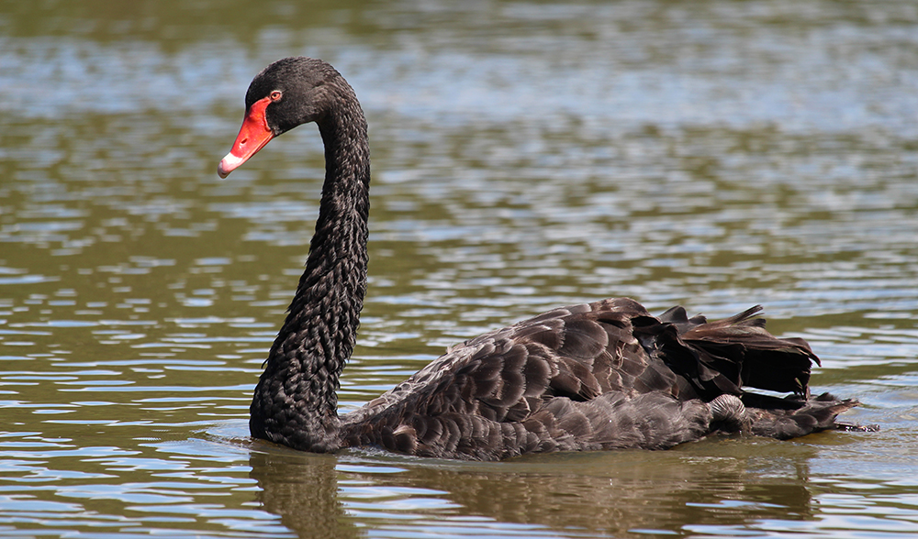
We need to be able to deal with these cases

Slide 54
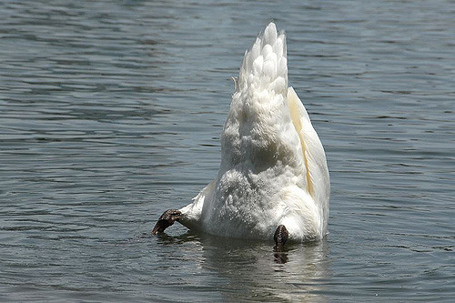
And these

Slide 55
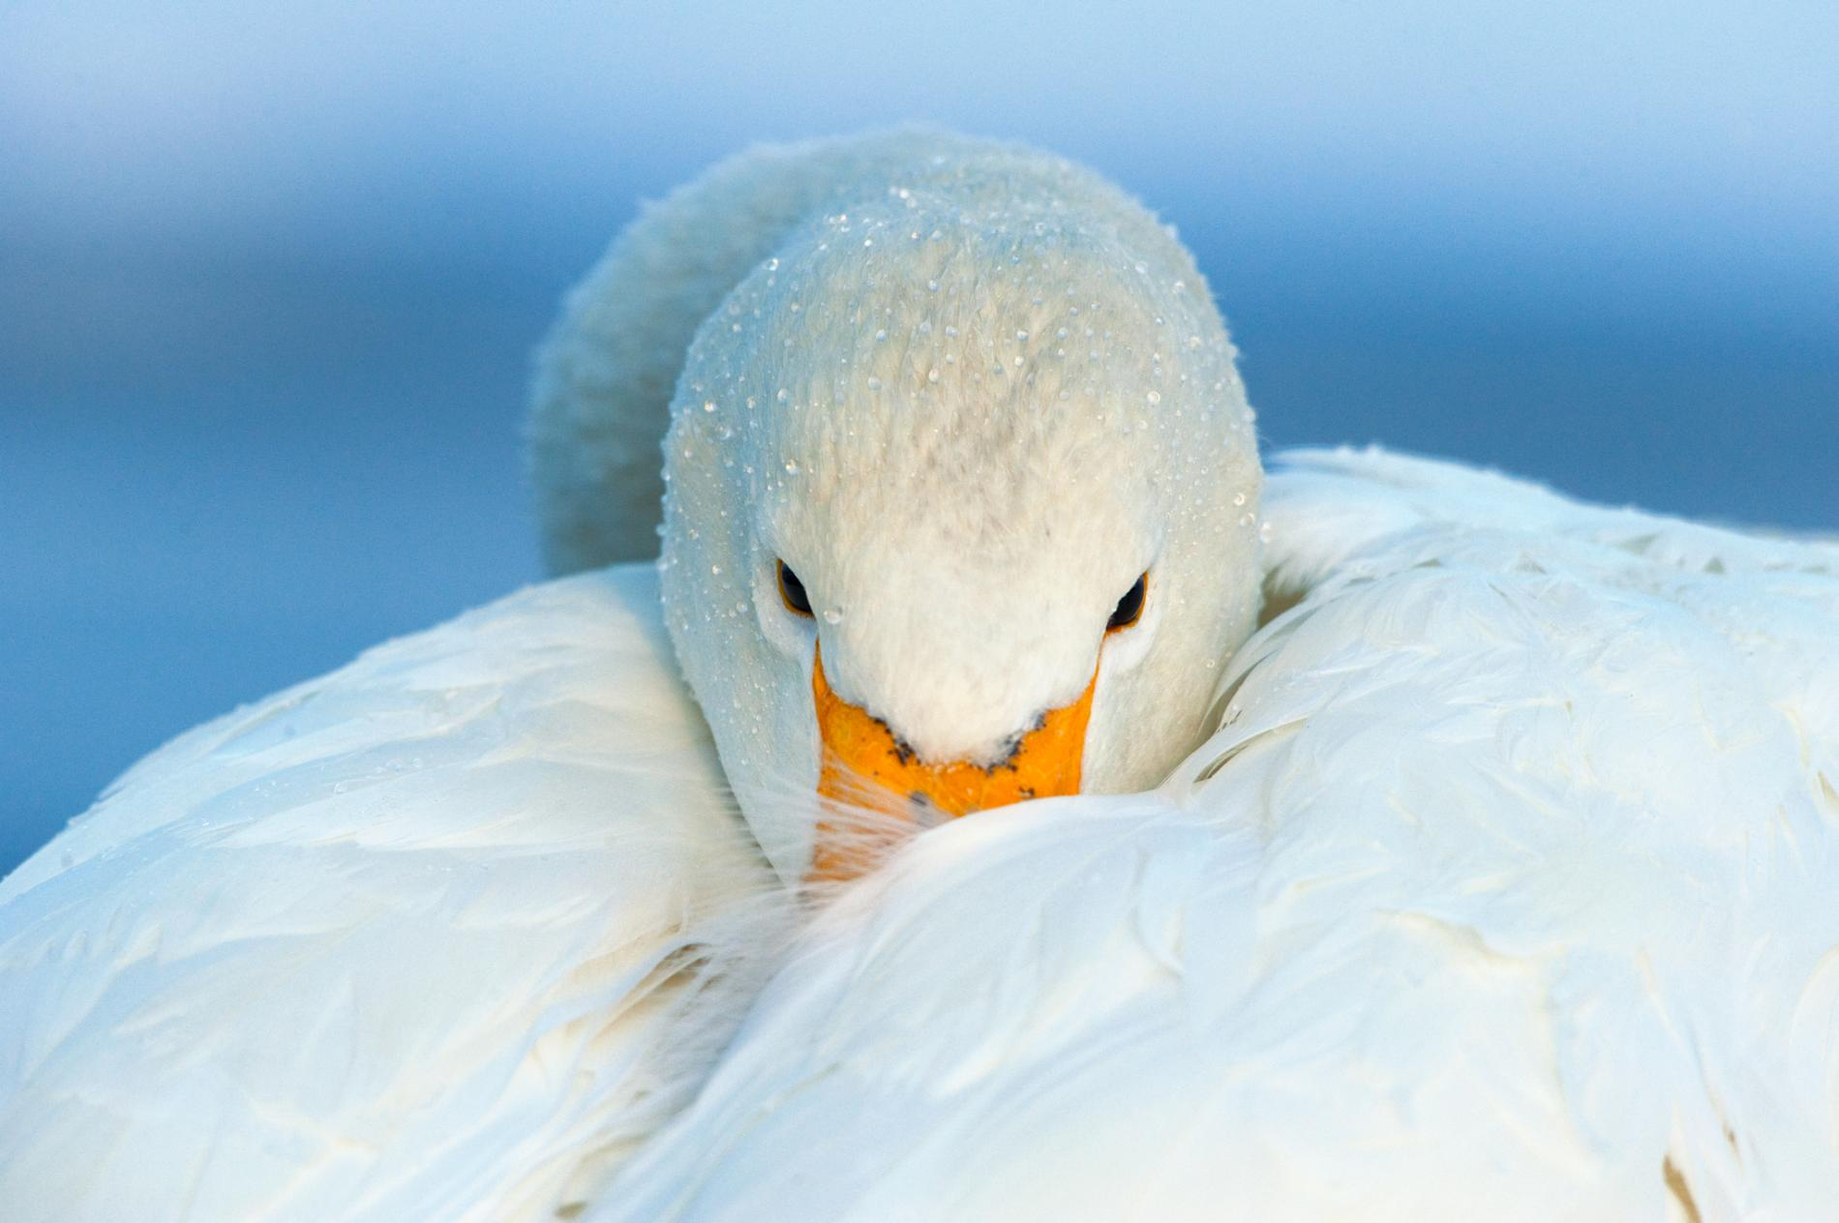
And these

Slide 56

And these

Slide 57
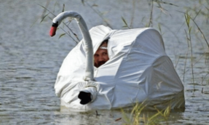
And these

Slide 58
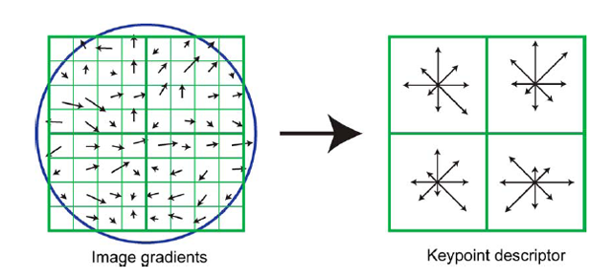

Image features
We’ve been basically talking about detecting features in images, in a very naïve way.
Researchers built multiple computer vision techniques to deal with these issues: SIFT, FAST, SURF, BRIEF, etc.
However, similar problems arose: the detectors where either too general or too over-engineered. Humans were designing these feature detectors, and that made them either too simple or hard to generalize.
SIFT feature descriptor
FAST corner detection algorithm

Slide 59
Image features (cont)
What if we learned the features?
We need a system that can do Representation Learning or Feature Learning.

Slide 60
Image features (cont)
What if we learned the features?
We need a system that can do Representation Learning or Feature Learning.
Representation Learning: technique that allows a system to automatically find relevant features for a given task. Replaces manual feature engineering.

Slide 61
Image features (cont)
What if we learned the features?
We need a system that can do Representation Learning or Feature Learning.
Representation Learning: technique that allows a system to automatically find relevant features for a given task. Replaces manual feature engineering.
Multiple techniques for this:
Unsupervised (K-means, PCA, …).
Supervised Dictionary learning
Neural Networks!

Slide 62

Some extra things to consider
Nearby Pixels are more strongly related that distant ones
Objects are built up out of smaller parts
Images are Local and Hierarchical

Slide 63




And images are invariant

Slide 64
Outline
Motivation
CNN basic ideas
Building a CNN

Slide 65
Each neuron from first layer has one weight per pixel. Recall, the importance of the predictors (here pixels) is given by the value of the coefficient, here the weight W.
In this case, the red weights will be larger to better recognize cat.
X
In this case, the blue weights will be larger.
X

Slide 66
Each neuron from first layer has one weight per pixel. Recall, the importance of the predictors (here pixels) is given by the value of the coefficient, here the weight W.
X
We are learning redundant features. Approach is not robust, as cats could appear in yet another position.
X

Slide 67

Solution: Cut the image to smaller pieces.
$$X:ℝ^{8×8}$$
64 weights per neuron

Slide 68

Solution: Cut the image to smaller pieces.
$$X:ℝ^{4×4}$$
$$X:ℝ^{8×8}$$
64 weights per neuron

Slide 69
Solution: Cut the image to smaller pieces.
$$X:ℝ^{4×4}$$
$$X:ℝ^{8×8}$$
64 weights per neuron

Slide 70
Solution: Cut the image to smaller pieces.
$$X:ℝ^{4×4}$$
$$X:ℝ^{8×8}$$
64 weights per neuron

Slide 71
Solution: Cut the image to smaller pieces.
$$X:ℝ^{4×4}$$
$$X:ℝ^{8×8}$$
64 weights per neuron
16 weights per neuron but 4 times more training examples.

Slide 72
Do the same for all images
$$X:ℝ^{4×4}$$
$$X:ℝ^{8×8}$$
64 weights per neuron
16 weights per neuron but 4 times more training examples.

Slide 73
What if the cat is not entirely in one of the 4 boxes?

Slide 74
What if the cat is not entirely in one of the 4 boxes?
$$X:ℝ^{4×4}$$
$$X:ℝ^{8×8}$$
64 weights per neuron

Slide 75
What if the cat is not entirely in one of the 4 boxes?
$$X:ℝ^{4×4}$$
$$X:ℝ^{8×8}$$
64 weights per neuron

Slide 76
What if the cat is not entirely in one of the 4 boxes?
$$X:ℝ^{4×4}$$
$$X:ℝ^{8×8}$$
16 weights per neuron but 25 times more training examples.
64 weights per neuron
Sliding Window

Slide 77





Convolution
$$x_{11}$$
$$h_{11}=f\left(W_{11}x_{11}+W_{12}x_{12}+…+W_{44}x_{44}+b\right)$$
$$x_{12}$$
$$⋮$$
$$⋮$$
16 weights
$$x_{44}$$
Index here represents the cutout
Input
Hidden Layer

Slide 78












Convolution
$$x_{11}$$
$$h_{11}=f\left(W_{11}x_{11}+W_{12}x_{12}+…+W_{44}x_{44}+b\right)$$
$$x_{12}$$
$$⋮$$
$$⋮$$
16 weights
$$x_{44}$$
Input
Hidden Layer
$$W_{11}$$
$$W_{12}$$
$$W_{13}$$
$$W_{14}$$
$$x_{11}$$
$$x_{12}$$
$$x_{13}$$
$$x_{14}$$
$$h_{11}=∑$$
$$⋆$$
$$W_{44}$$
$$x_{44}$$
Element wise multiplication and addition of all products

Slide 79









Convolution
$$x_{11}$$
$$h_{12}=f\left(W_{11}x_{11}+W_{12}x_{12}+…+W_{44}x_{44}+b\right)$$
$$x_{12}$$
$$⋮$$
$$⋮$$
16 weights
$$x_{44}$$
Input
Hidden Layer
$$W_{11}$$
$$W_{12}$$
$$W_{13}$$
$$W_{14}$$
$$x_{11}$$
$$x_{12}$$
$$x_{13}$$
$$x_{14}$$
$$h_{12}=∑$$
$$⋆$$
$$W_{44}$$
$$x_{44}$$
Element wise multiplication and addition of all products

Slide 80












Convolution
$$W_{11}$$
$$W_{12}$$
$$W_{13}$$
$$W_{14}$$
$$x_{11}$$
$$x_{12}$$
$$x_{13}$$
$$x_{14}$$
$$h_{ij}=∑$$
$$⋆$$
$$W_{44}$$
$$x_{44}$$

Slide 81

Convolution
$$W_{11}$$
$$W_{12}$$
$$W_{13}$$
$$W_{14}$$
$$x_{11}$$
$$x_{12}$$
$$x_{13}$$
$$x_{14}$$
$$h_{ij}=∑$$
$$⋆$$
$$W_{44}$$
$$x_{44}$$
KERNEL, K
X is the cutout of image center at $\{i,j$}

Slide 82


Convolution
$$W_{11}$$
$$W_{12}$$
$$W_{13}$$
$$W_{14}$$
$$x_{11}$$
$$x_{12}$$
$$x_{13}$$
$$x_{14}$$
$$h_{ij}=∑$$
$$⋆$$
$$W_{44}$$
$$x_{44}$$
Index here represents the output from this operation
KERNEL, K
X is the cutout of image center at $\{i,j$}
Element wise multiplication and addition of all products
$$=$$
CONVOLUTION
$$H=K⋆X$$

Slide 83


Convolution and cross-correlation
A convolution of $f$ and $g$, $(f∗g)$, is defined as the integral of the product, having one of the functions inverted and shifted:
$$\left(f∗g\right)\left(t\right)=\int_{a}{f\left(a\right)g\left(t−a\right)da}$$
Discrete convolution:
$$\left(f∗g\right)\left(t\right)=\sum_{a=−∞}^{∞}{f\left(a\right)g(t−a)}$$
Discrete cross-correlation:
Function is inverted and shifted left by t
$$\left(f⋆g\right)\left(t\right)=\sum_{a=−∞}^{∞}{f\left(a\right)g(t+a)}$$

Slide 84

“Convolution” Operation
Source Pixel
(-1x3)+(0x0)+(1x1)+ (-2x2)+(0x6)+(2x2)+
(-1x2)+(0x4)+(1x1)=-3
Convolution Kernel [WE’LL NEED TO LEARN IT]
Destination Pixel
Kernel Map

Slide 85


Convolutions – step by step

Slide 86

Convolutions – another example

Slide 87
“Convolution” Operation in action
What does convolving an image with a Kernel do?
wikipedia.org

Slide 88


“Convolution” Operation in action
What does convolving an image with a Kernel do?
Kernel
Edge detection
*
=
Sharpen
*
=

Slide 89
A Convolutional Network
+ ReLU
Why more than one layer?
+ ReLU
What is this square?
What are feature maps and why multiple feature maps?
What is going on here?
What is Pooling?

Slide 90
A Convolutional Network
+ ReLU
Why more than one layer?
+ ReLU
What is this square?
What are feature maps and why multiple feature maps?
What is going on here?
What is Pooling?

Slide 91

“Convolution” Operation
RGB Image
(7x7x3)
Convolution Filter
(3x3x3)
Convolution Kernels
Feature Map
(7x7x1)

Slide 92
A Convolutional Network
+ ReLU
Why more than one layer?
+ ReLU
What are feature maps and why multiple feature maps?
What is going on here?
What is Pooling?

Slide 93
Why more than one feature map?
LAYER 1:

Slide 94
Why more than one feature map?
LAYER 1:
Filter 1: Horizontal Lines

Slide 95
Why more than one feature map?
LAYER 1:
Filter 1: Horizontal Lines
Filter 2: Vertical Lines

Slide 96
Why more than one feature map?
LAYER 1:
Filter 1: Horizontal Lines
Filter 2: Vertical Lines
Filter 3: Orange bulb

Slide 97
Why more than one feature map?
LAYER 1:
Filter 1: Horizontal Lines
Filter 2: Vertical Lines
Filter 3: Orange bulb
Different filters identify different features.

Slide 98

“Convolution” Operation
RGB Image
(7x7x3)
3 Convolution Filters
(3x3x3)
3 Feature Maps
(7x7x3)

Slide 99
A Convolutional Network
+ ReLU
Why more than one layer?
+ ReLU
What are feature maps and why multiple feature maps?
What is going on here?
What is Pooling?

Slide 100
Why more than one layer?

Slide 101
Why more than one layer?
Layer 2, Filter 1: Combines horizontal and vertical lines from Layer 1 produce diagonal lines.

Slide 102
Why more than one layer?
Layer 2, Filter 1: Combines horizontal and vertical lines from Layer 1 produce diagonal lines.
Layer 3, Filter 1: Combines diagonal lines to identify shapes

Slide 103
A Convolutional Network
+ ReLU
Why more than one layer?
+ ReLU
What is Pooling?
What is going on here?

Slide 104
So far
We know that MLPs:
Do not scale well for images
Ignore the information brought by pixel position and correlation with neighbors
Cannot handle translations

Slide 105
So far
We know that MLPs:
Do not scale well for images
Ignore the information brought by pixel position and correlation with neighbors
Cannot handle translations
The general idea of CNNs is to intelligently adapt to properties of images:
Pixel position and neighborhood have semantic meanings.
Elements of interest can appear anywhere in the image.

Slide 106

Basics of CNNs
MLP
CNN
CNNs are also composed of layers, but those layers are not fully connected: they have filters, sets of cube-shaped weights that are applied throughout the image. Each 2D slice of the filters are called kernels.
These filters introduce translation invariance and parameter sharing.
How are they applied? Convolutions!

Slide 107




Convolutions – what happens at the edges?
If we apply convolutions on a normal image, the result will be down-sampled by an amount depending on the size of the filter.
We can avoid this by padding the edges in different ways.

Slide 108


Padding
Full padding. Introduces zeros such that all pixels are visited the same number of times by the filter. Increases size of output.
Same padding. Ensures that the output has the same size as the input.

Slide 109



Stride
Stride controls how the filter convolves around the input volume.
The formula for calculating the output size is:
Where O is output dim, W is the input dim, K is the filter size, P is padding and S the stride
Stride = 1
Stride = 2
$$O=\frac{W−K+2P}{S}+1$$

Slide 110


Exercise: Pavlos vs Not Pavlos
The aim of this exercise is to train a dense neural network and a CNN to compare the parameters between them
Augment the dataset since we only have one image of Pavlos and the eagle
Build a simple feed-forward network and train it
Use the convolution layer to build a simple CNN and train it like the network before
Compare performance and parameters

Slide 111
A Convolutional Network
+ ReLU
+ ReLU
What is Pooling?
What is going on here?

Slide 112
Common Question after this class
It is said that people often choose 3 or 5 as the size of the kernel, are there any advantages this kernel size could have?
Why do we need pooling?
Would it be possible that CNN without pooling could also have good performance? Are there any alternative?
How to calculate the number of parameters in a CNN?
Does a CNN with more convolutional layers necessarily have a better performance than a CNN with less layers?
Why we need a dense layer after the whole convolved layers?
Do CNNs have any drawbacks such as vanishing or exploding gradients like simple MLPs?

